Slide 1
Chongqing University of Technology
ATAI
Advanced Technique of Artificial Intelligence
Chongqing Unive
MODELING INTENTION, EMOTION AND EXTERNAL WORLD IN DIALOGUE SYSTEMS
(ICASSP-2022)
Reported by Jia Wang
Notes:
在对话系统中塑造意图、情感和外部世界

Slide 2
Chongqing University of Technology
ATAI
Advanced Technique of Artificial Intelligence
Chongqing University of Technology
1. Introduction
2. Approach
3. Experiments

Slide 3
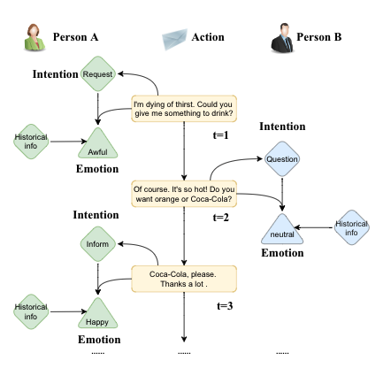
Introduction
Notes:
意图识别和情感预测是对话系统长期研究的课题。意图是刺激和引导行为的必要心理背景，是人们进行活动的内在动力倾向，从而影响着外部世界的状态。
也就是说，情感既是由自身的意图决定的，也是由外部行为决定的.。当行为满足意图时，它通常会表现出积极的情绪。

Slide 4
Introduction
• In this paper, we propose a RelAtion Interaction Network (RAIN), consisting of Intention Relation Module and Emotion Relation Module, to jointly model mutual relationships and explicitly integrate historical intention information. Specifically, Intention Relation Module introduces an intention dictionary to explicitly account for the intention recognition task. Then,Emotion Relation Module designs an intention fusion mechanism to explicitly integrate historical intention information for subsequent emotion prediction. The important observation is the significant performance obtained from RAIN; it not only achieves the high performance on the dataset but also makes an explanation of the two tasks.
Notes:
以往的研究主要集中在意图识别或情绪预测方面，但很少将这些因素综合考虑，且忽略了对历史意图信息的显式整合。

Slide 5
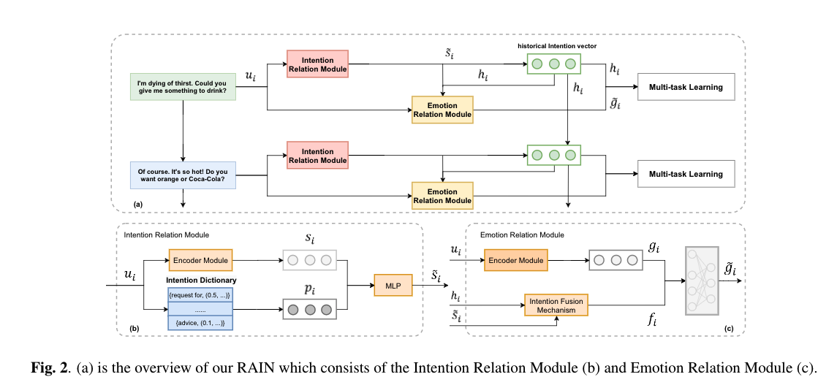
Approach
Notes:
首先，意图关系模块(b)通过考虑者模块获得对话的上下文表示，并引入意图字典进行可解释的意图识别。情感关系模块(c)设计意图融合机制，显式集成历史意图信息。最后，RAIN利用意图向量̃si和情绪向量̃gi多任务学习进行后续预测

Slide 6
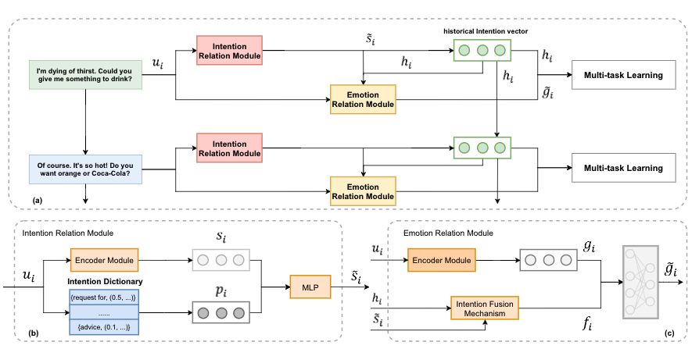
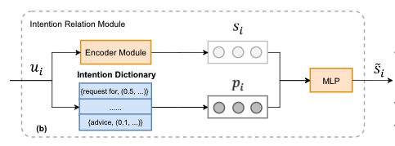
Approach
Intention Relation Module
Encoder Module.
Notes:
我们使用robert作为Encoder模块来获取上下文表示，为了获得第i个句子表示，我们考虑使用[CLS]对应的隐藏状态。

Slide 7
Approach
Intention Relation Module
Intention Dictionary.
Observing that certain specific words such as ask for, proposal can reflect intention, we extract the feature words in the process of labeling the feature. For example,request for, would like has a high probability of being request. We count the number of labeled feature words, count the word frequency of each feature word over different intentions, and normalize it to get the probability distribution pi.Therefore, we construct an Intention Dictionary as the prior intention knowledge base (Figure (b)) and then output a probability distribution pi of the keyword over all the corresponding intentions, which can be regarded as an interpretable signal to enhance the semantic of the intention.
Notes:
观察到特定的词如ask for、proposal能反映意图，我们在标记特征的过程中提取特征词。例如，request for, would like有很高的概率被请求。通过统计特征词在不同意图下出现的频率，并将其归一化得到概率分布pi。因此，我们构建一个意图字典作为先验的意图知识库(图2 (b))，然后输出关键词在所有对应意图上的概率分布，这可以被视为一个增强意图语义的可解释信号.

Slide 8
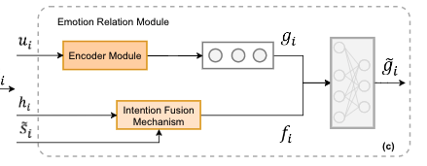
Approach
Emotion Relation Module
Intention Dictionary.
Historical Intention Modeling
Notes:
观察到特定的词如ask for、proposal能反映意图，我们在标记特征的过程中提取特征词。例如，request For, would like有很高的概率被请求。通过统计特征词在不同意图下出现的频率，并将其归一化得到概率分布pi。因此，我们构建一个意图字典作为先验的意图知识库(图2 (b))，然后输出关键词在所有对应意图上的概率分布，这可以被视为一个增强意图语义的可解释信号.

Slide 9
Approach
Emotion Relation Module
Intention Fusion Mechanism.
Notes:
观察到特定的词如ask for、proposal能反映意图，我们在标记特征的过程中提取特征词。例如，request For, would like有很高的概率被请求。通过统计特征词在不同意图下出现的频率，并将其归一化得到概率分布pi。因此，我们构建一个意图字典作为先验的意图知识库(图2 (b))，然后输出关键词在所有对应意图上的概率分布，这可以被视为一个增强意图语义的可解释信号.

Slide 10
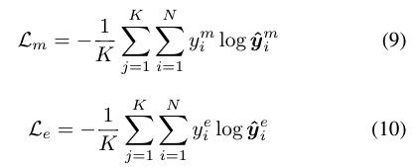
Approach
Prediction for Intention and Emotion
Notes:
观察到特定的词如ask for、proposal能反映意图，我们在标记特征的过程中提取特征词。例如，request For, would like有很高的概率被请求。通过统计特征词在不同意图下出现的频率，并将其归一化得到概率分布pi。因此，我们构建一个意图字典作为先验的意图知识库(图2 (b))，然后输出关键词在所有对应意图上的概率分布，这可以被视为一个增强意图语义的可解释信号.

Slide 11
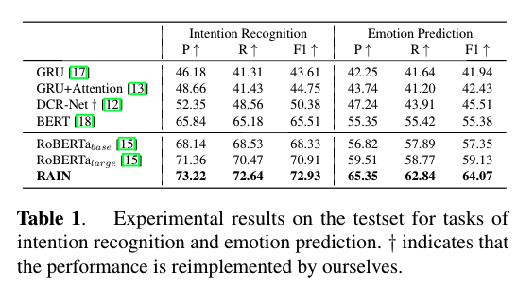
Experiments
Notes:
Multi-task learning methods（MTL）

Slide 12
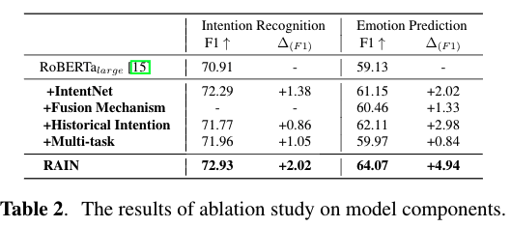
Experiments

Slide 13
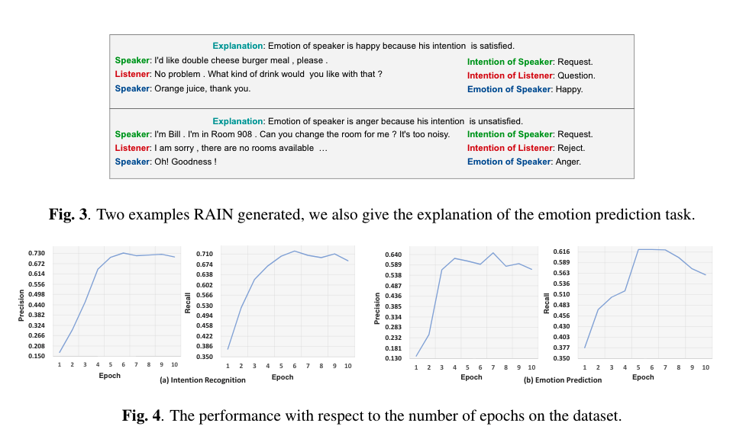
Experiments

Slide 14
Thanks！

